Slide 1



Valdosta Rail Depot Project
Author- Matthew Kolakowski
Center for South Georgia Regional Impact at Valdosta State University

Slide 2
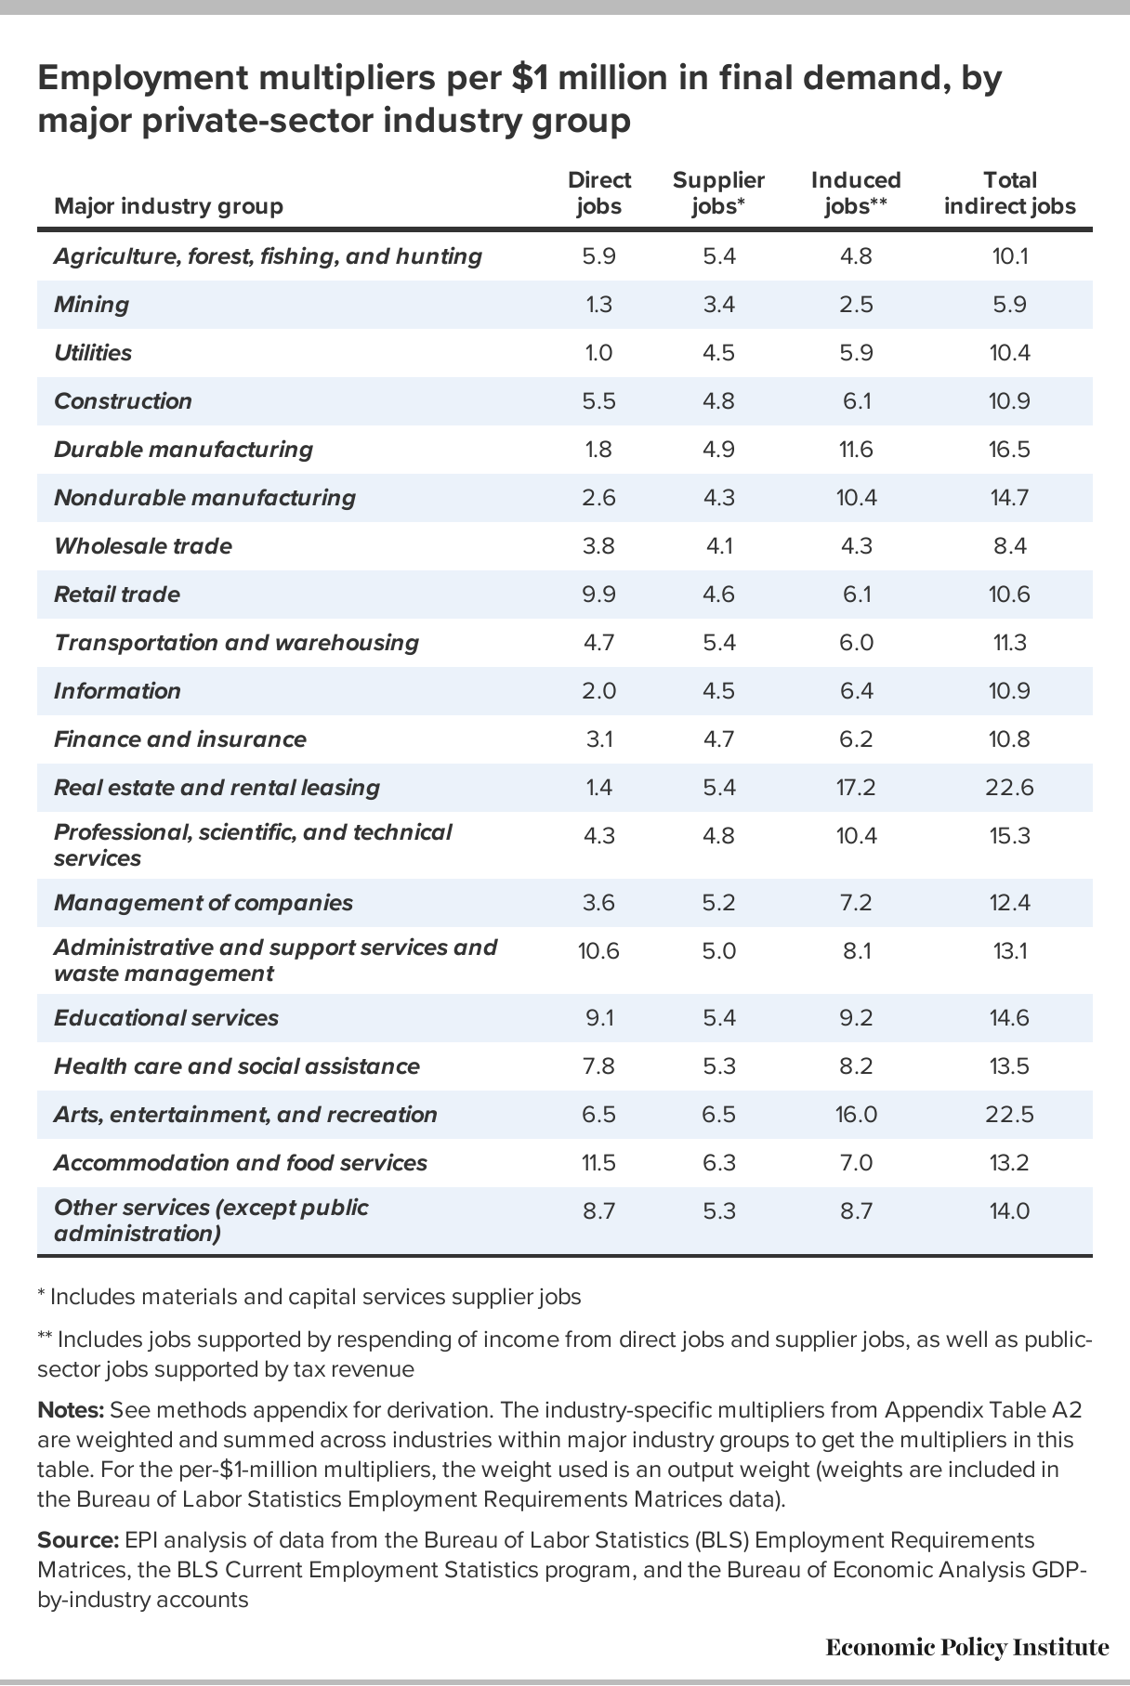
Valdosta Rail Depot Project Benefits
The historic downtown Valdosta area could
realize three major benefits from the completion
of the Valdosta Rail Depot project-
An increase in employment rates (22.5
Indirect Jobs for every $1 in economic activity
generated).
2. Reignite locals to go out to eat during the
week and increase average customer spend
on the weekends.
3. Create an environment that
encourages middle and upper-middle class
tourist to take a quick detour off I-75 and
spend downtown rather than interstate
adjacent.

Slide 3
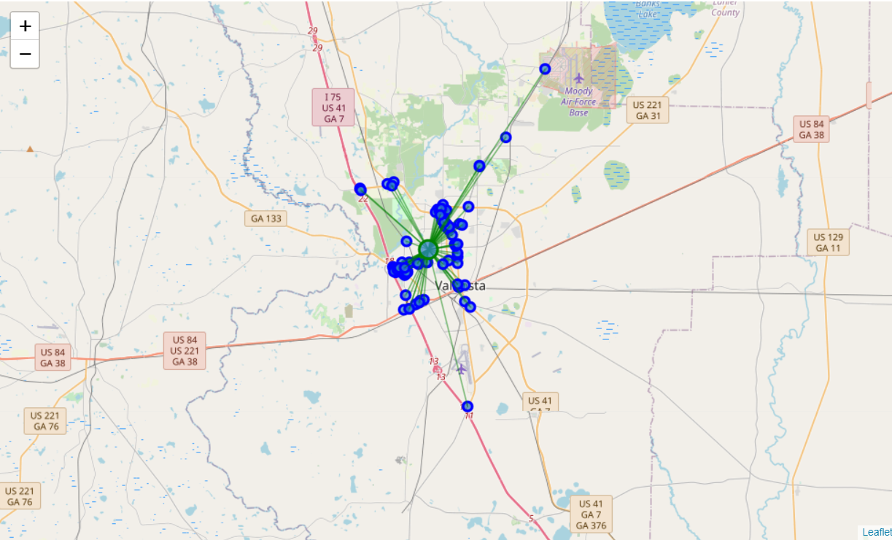
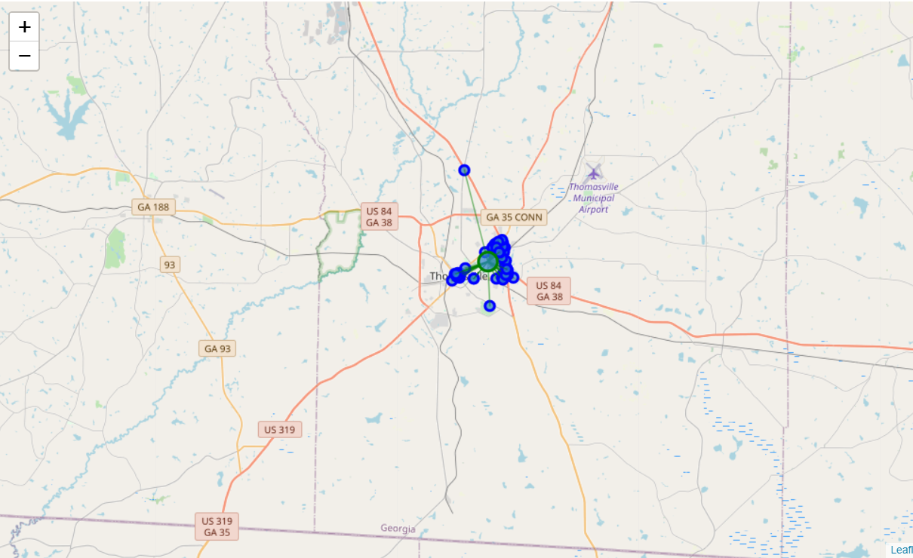
Visual Comparison of Restaurants in Valdosta
(Top Photo) and Thomasville (Bottom Photo)
Georgia
The top photo depicts a visualization of Valdosta
Restaurant’s location in comparison to the center
of downtown. If you look at the bottom picture of
Thomasville, it shows a configuration of Restaurant’s
more likely to encourage visitors to seek out traveling
downtown.
Currently, Valdosta has a more spread-out Restaurant
configuration that while improving from 2018 to 2021,
the Rail Depot Project would entice consumers to travel
to downtown Valdosta more frequently to visit the food
truck park and other planned attractions.

Slide 4
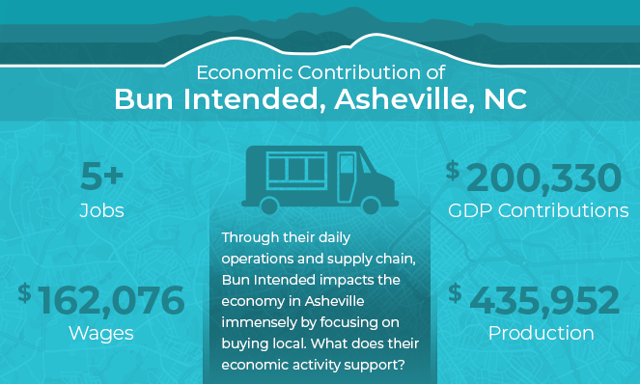
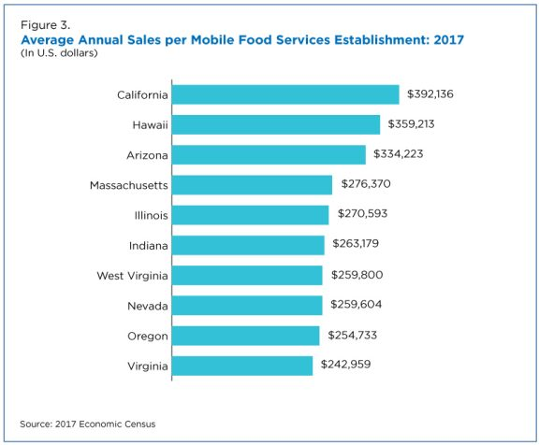
What’s the Yearly Economic Impact of One Food Truck
As the COVID-19 vaccination plan in the
United States, careful and considerate economic activity will likely pick up. Although small, an individual food truck can contribute over $150,000 (A conservative estimate) annually to Valdosta Georgia economy. If the food truck park was open year-round (Which is possible due to Valdosta’s temperate climate), a food truck park with seven trucks could reasonably generate $1.050 to $1.4 million dollars annually in GDP contributions.

Slide 5

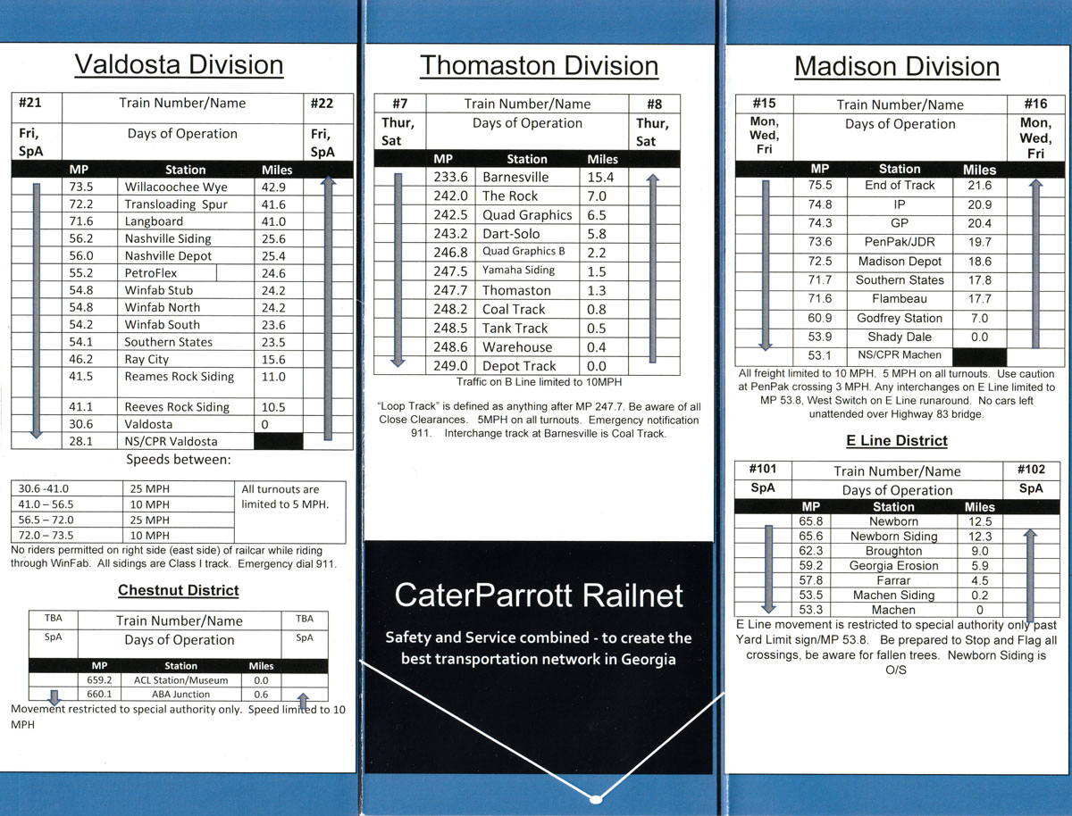
CaterParrott Railnet Division Rail Routes
Pro:
Existing routes already going through
Valdosta on a scheduled basis providing
direct and indirect economic benefits
from associated rail transportation
employment and maintenance costs.
Con:
Would like to see another day or perhaps
if demand could increase, two additional
days of operation out of trains #21
and #22.

Slide 6
Next Steps
Determine project costs.
Determine required payback period if investor or financial institution funding is involved (If Applicable).
Determine whether an increase of live music and events during the spring, summer, and early fall are a part of the strategic vision for the revitalized area.
Come together to work out the ratio (Economic Development Dollars Spent Versus Economic Impact) and see if that aligns with moving forward with a full economic impact analysis.

Slide 7

Contact
Matthew Kolakowski
Cell- 2542898123
mjkolakowski@valdosta.edu

